Slide 1
Visual Analytics Engineering in Computer Science - Sapienza Class 2019-2020 Matteo Rizza, Nicola Di Santo

Slide 2
Introduction
Tools of network medicine to explore the molecular complexity of a diseases are emerging.
Essential for identifying: new disease genes, disease-associated mutations, drug targets and biomarkers for complex diseases.
Goal: Provide an interactive visual system to navigate and process huge amount of network medicine data.

Slide 3
Dataset
Datasets from OMIM (Online Mendelian Inheritance in Man).
Interactome Dataset: relational dataset made of 141000 tuples, 5 labels. After cutting 39000 tuples, respecting requirement of ASindex > 10000.
Seeds Dataset: key-value dataset (disease name, [list of genes]).
Drug Target Dataset: several labels such as name of drug, list of targeted genes.

Slide 4
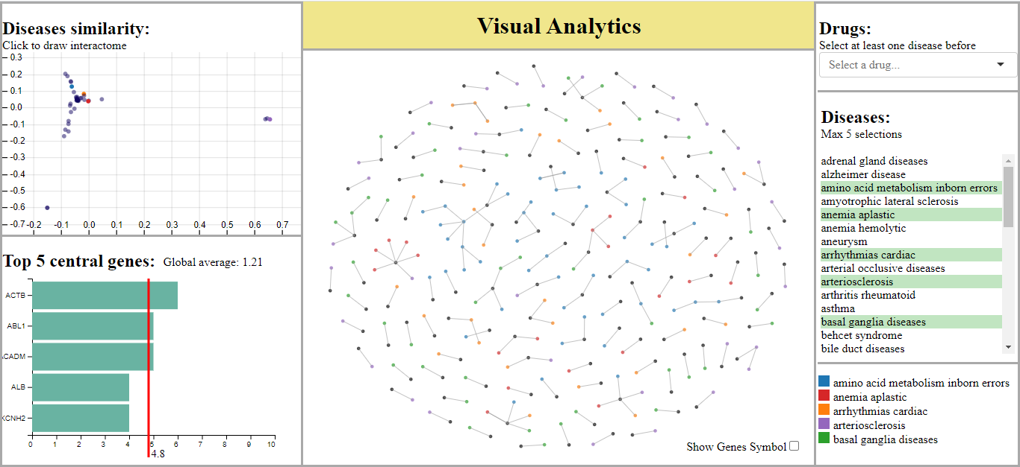
The system
Three main visualizations plus some filter components.
Diseases scatterplot view.
Sidebar with filters (at most 5 diseases).
Node-link diagram.
Barplot of top 5 centrality genes.

Slide 5
Diseases scatterplot view
Each disease represented as a point.
0.5 opacity to make overlapping points visible.
Zoomable view to distinguish near points.
Distance defined using Jaccard Similarity.
MDS applied on distance matrix to obtain 2-D points for each disease.

Slide 6
Diseases interactome view
Node-link diagram showing all the links between genes of the selected diseases.
Two levels of connection degree showed.
Different colors assigned to different diseases.
Possibility to highlight genes targeted by specific drugs.

Slide 7
Top 5 central genes barplot
Centrality defined as the number of connections a gene has (centrality for social graphs).
Live and dynamic statistic because computed only for the displayed genes.
Also informations about average values.

Slide 8
Coordination Between Views
Scatterplot view directly coordinated with interactome view and sidebar disease selector, indirectly with the top 5 view.
Top 5 centrality view directly connected with interactome graph.
The legenda acts on the network and shares the same color schema with the interactome nodes and the scatterplot points.
Disease selector is coordinated together with the network and the scatterplot.
Drug selector affects only the network.

Slide 9
Conclusions
This visualization system is heavily inspired by NEMESIS.
As NEMESIS, we visualize degree one and two relationships between genes.
Differently from NEMESIS, we provide a view based on node-link diagram. Moreover, we gave freedom to the users to drive their research through a complete list of diseases and gave possibility to analyze also interactions with drugs.
In conclusion our system aspires to become an integration rather than an alternative to NEMESIS to provide a 360-degree view to the potential users and satisfy their needs.
Rizza Matteo: https://www.linkedin.com/in/matteo-rizza/
Di Santo Nicola: https://www.linkedin.com/in/nicola-di-santo-b98647192/

